Slide 1


Linear Algebra
Bhushan Poojary

Slide 2
What This Course Is About
Computer Graphics
Quantum Computing
Data Science and Machine Learning
Network Analysis
Engineering and Physics

Slide 3
What You’ll Learn
✅ Understand and visualize vectors, matrices, subspaces, and transformations ✅ Solve systems of equations and compute inverses, eigenvalues, and eigenvectors ✅ Apply SVD for dimensionality reduction and least squares for regression ✅ Understand orthogonality, diagonalization, and spectral theorems ✅ Use linear algebra in applications like PageRank, PCA, Markov chains

Slide 4
Who Is This Course For?
This course is perfect for:
University students studying math, engineering, or CS
Self-learners aiming to master machine learning, quantum computing, or 3D graphics
Researchers or developers who need solid mathematical foundations

Slide 5
Prerequisites
You don’t need to be a math expert, but you should be comfortable with:
Basic algebra (solving equations, manipulating expressions)
High-school level geometry (vectors, slopes, basic trigonometry)
Some exposure to functions and graphs
Optional but helpful:
Familiarity with matrix notation or basic programming (e.g., Python, MATLAB, NumPy)
Throughout the course, we’ll explain concepts from the ground up, but also provide advanced insights for those aiming to dive deeper.

Slide 6


Tools You May Use
While the course focuses on theory, you can follow along using tools like:
Python (NumPy, Matplotlib) for hands-on matrix computation and visualization
Matlab or Octave if you're from an engineering background
Geogebra or Desmos for vector visualization

Slide 7
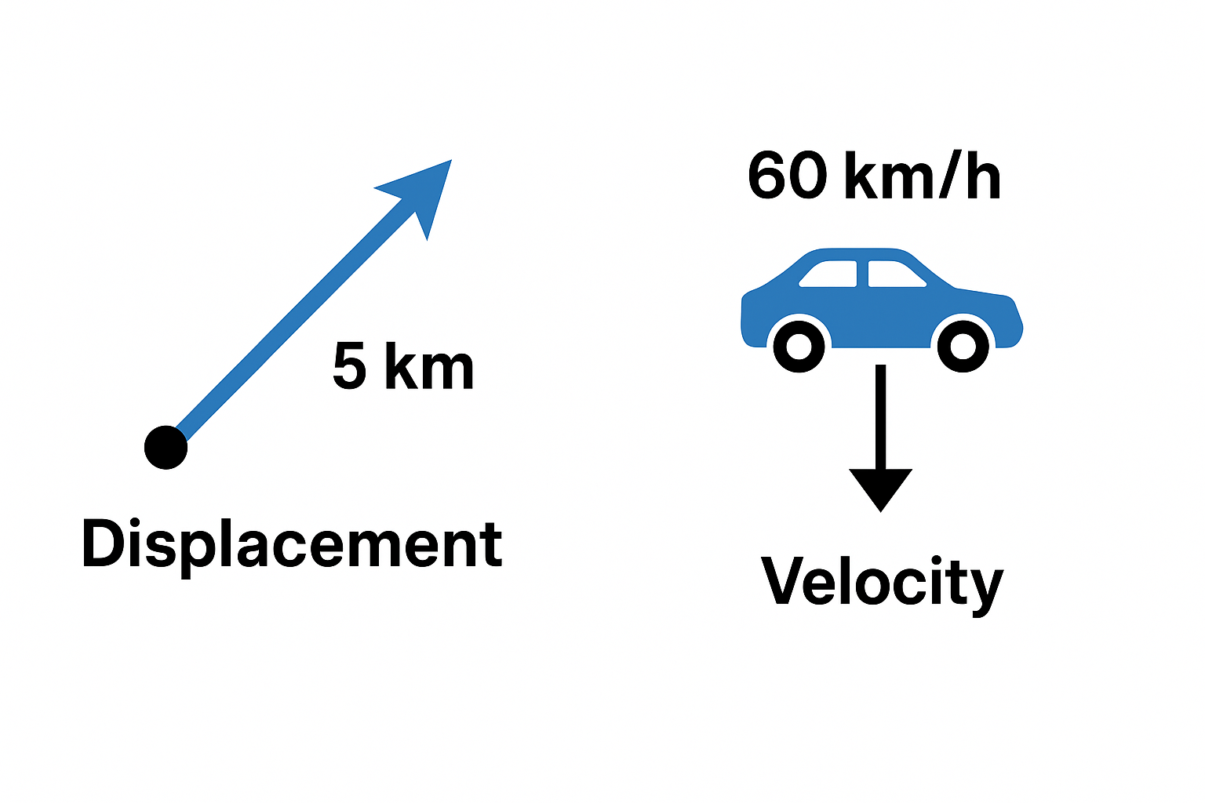
Vectors and Linear Combinations
What Are Vectors?
Analogy: Think of a vector as an arrow that points in a certain direction and has a certain length.
Real-life examples:
Displacement: 5 km northeast
Velocity: 60 km/h south

Slide 8


Vectors and Linear Combinations
Definition
A vector is a quantity with magnitude and direction.
In 2D, it looks like:
In 3D:

Slide 9
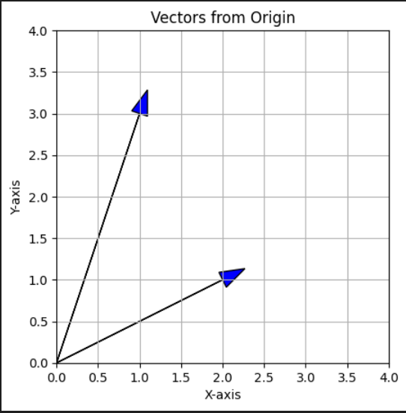
Vectors and Linear Combinations
Visual Demo (Using Python)
Vector (2, 1), (1, 3)

Slide 10
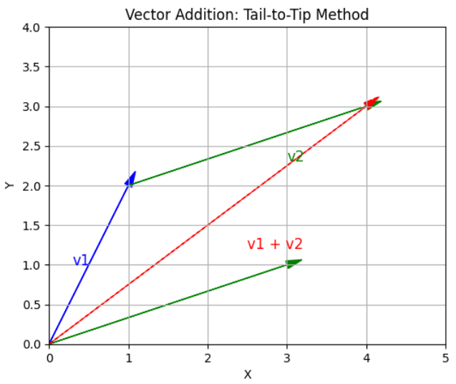

Vectors and Linear Combinations
Part 2: Vector Operations
➕ Vector Addition
"Tail-to-tip" method visually.

Slide 11
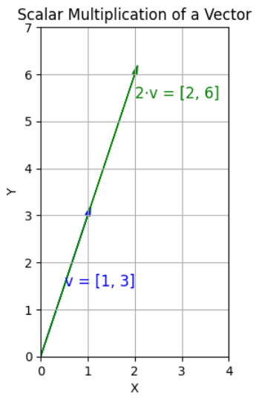

Vectors and Linear Combinations
✖️ Scalar Multiplication
Stretch or shrink a vector:

Slide 12

Vectors and Linear Combinations
Part 3: Linear Combinations
🧱 Concept
A linear combination is when you combine vectors using scalar multiplication and addition.
Example
$c_{1}{\overline{v}}_{1}$ + ${c_{2}\overline{v}}_{2}$
is a linear combination of ${\overline{v}}_{1}$ and ${\overline{v}}_{2}$

Slide 13

Vectors and Linear Combinations
Part 3: Linear Combinations
🧰 Concrete Example
${\overline{v}}_{1}= \left[\begin{matrix}1 \\ 0\end{matrix}\right]$ , ${\overline{v}}_{2}= \left[\begin{matrix}0 \\ 1\end{matrix}\right]$
These are unit vectors (basis vectors in 2D).
Any vector like $\left[\begin{matrix}3 \\ 2\end{matrix}\right]$ can be written as: 3${\overline{v}}_{1}$ + ${2\overline{v}}_{2}$

Slide 14
Vectors and Linear Combinations
Part 4: Why Linear Combinations Matter
They allow us to build new vectors from a few starting vectors (called basis vectors).
Foundation for solving systems of equations, understanding vector spaces, and building transformations.

